Slide 1
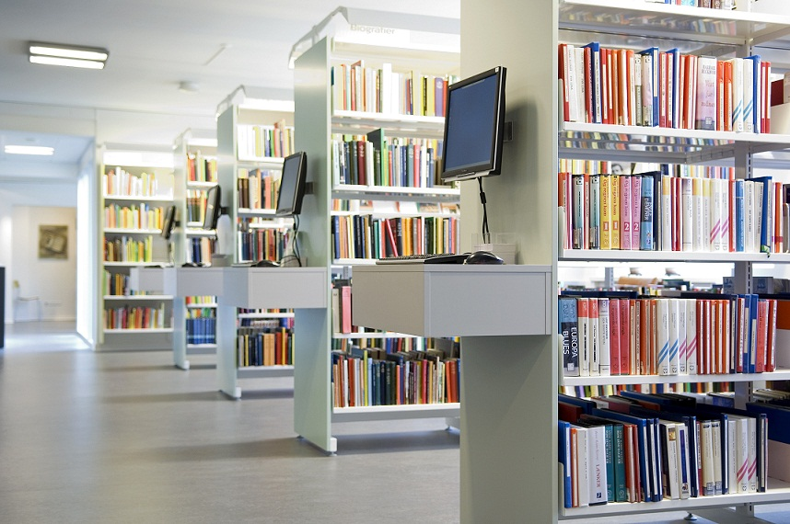

The Library Management System
Presented by: Mikiege Dupres & Alphonso Jn Pierre
Course: Computer and Information Technology
Instructor: Kem Emmanuel
Date: Wednesday 14th May 2025

Slide 2

A Day at the SALCC Library (skit)

Slide 3

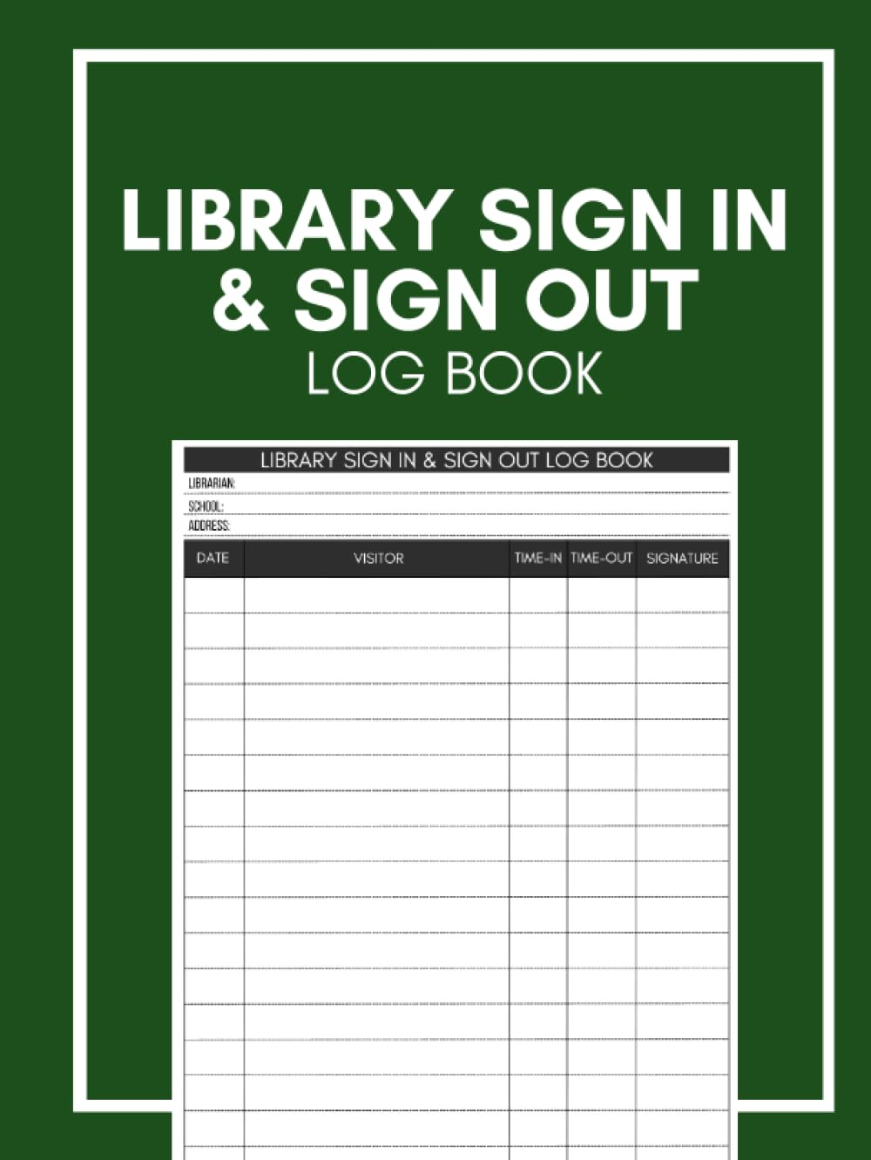

What’s the Problem?
Manual booking systems = inefficiency
Overcrowding and resource hogging
No centralized system to track or manage booking

Slide 4
Our Goal & Who We Help
Provide a smart, digital booking platform
Help students book and manage space efficiently
Give admins tools to manage resources and logs
Users: Students | Librarians | Admins

Slide 5
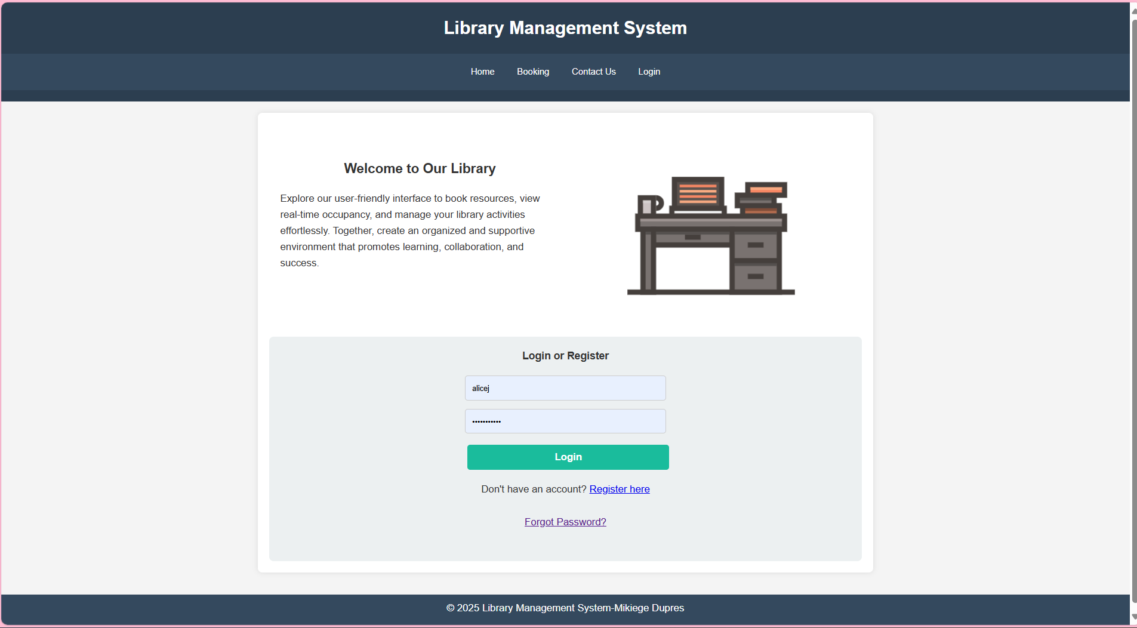
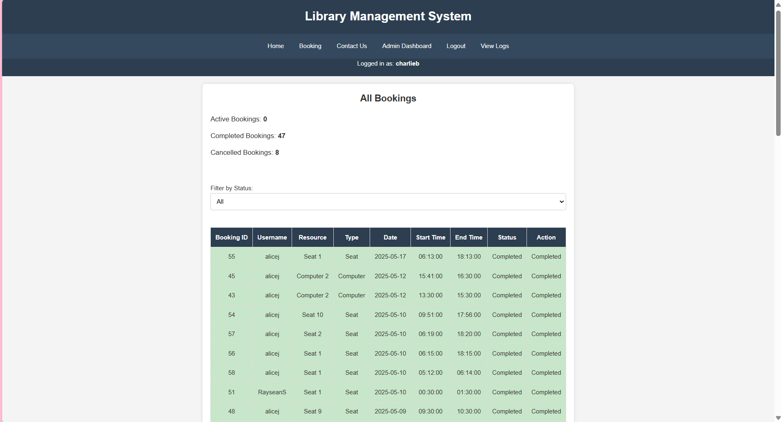
What We Built
Web-based system with secure login
Real-time resource updates
Admin dashboard for oversight

Slide 6



How We Built It
Frontend: HTML, CSS, JavaScript
Backend: PHP (Laragon)
Database: MySQL (phpMyAdmin)
Environment: XAMPP (for database)

Slide 7
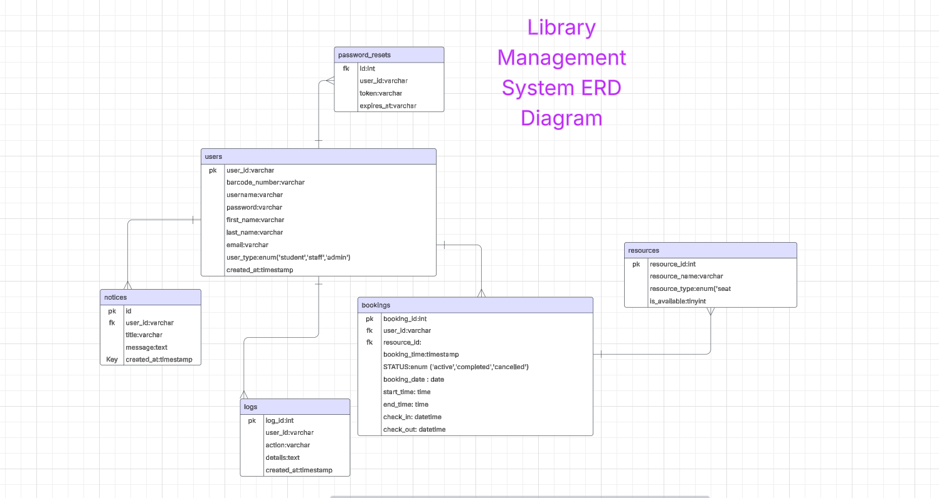
How It Works Behind the Scenes
This ERD shows the core database structure, including user roles, resource booking, and system logs.

Slide 8
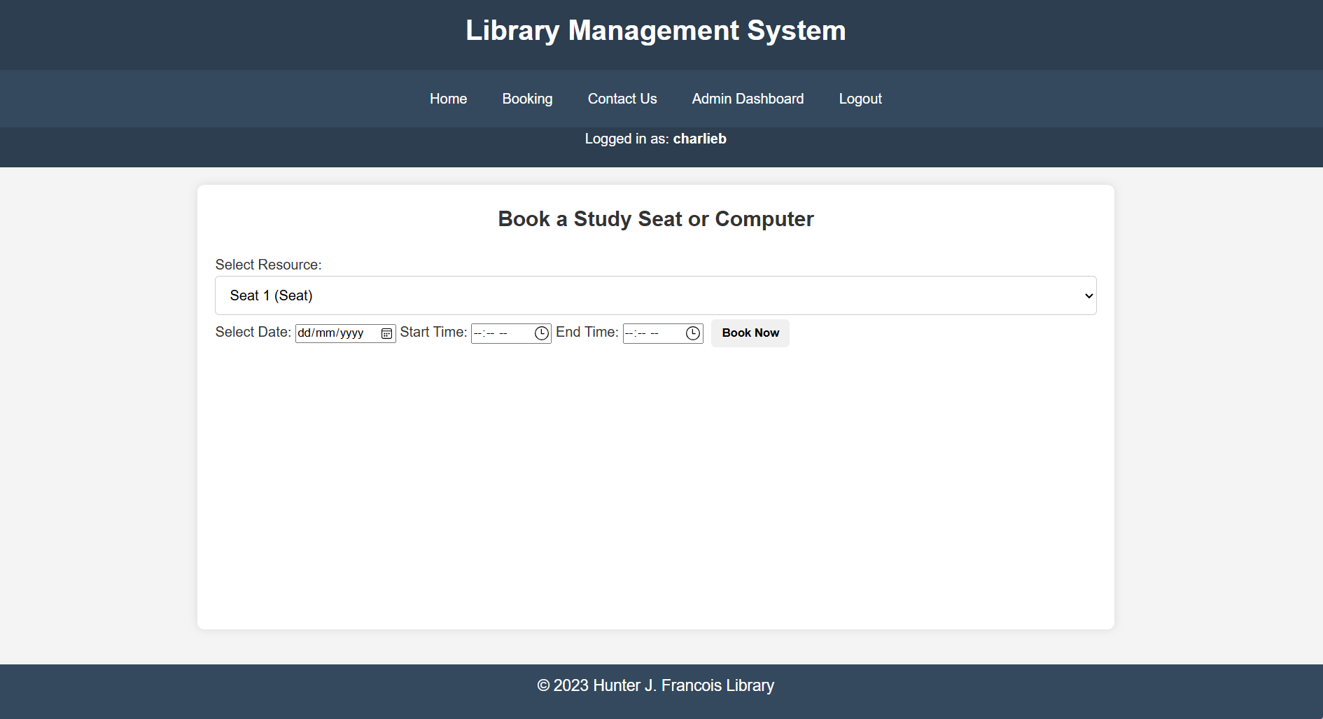
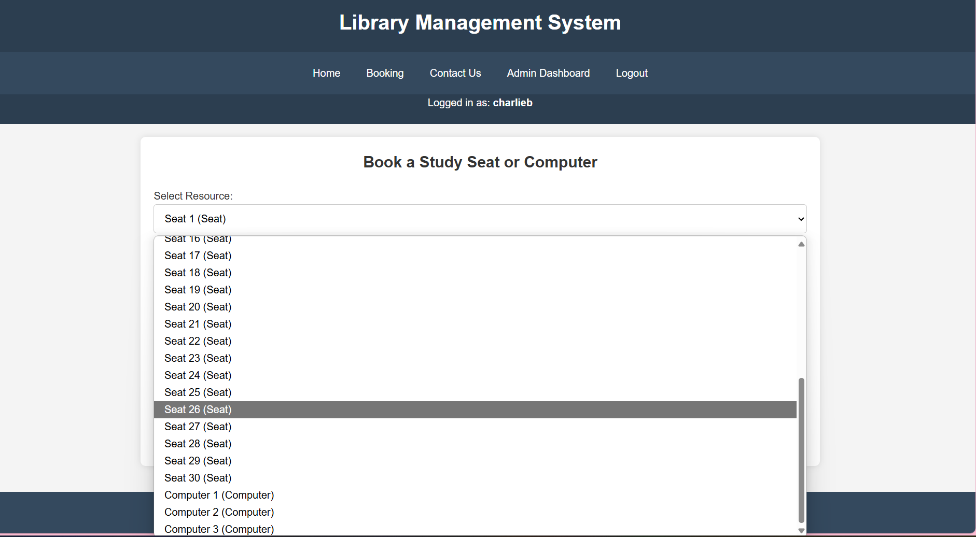
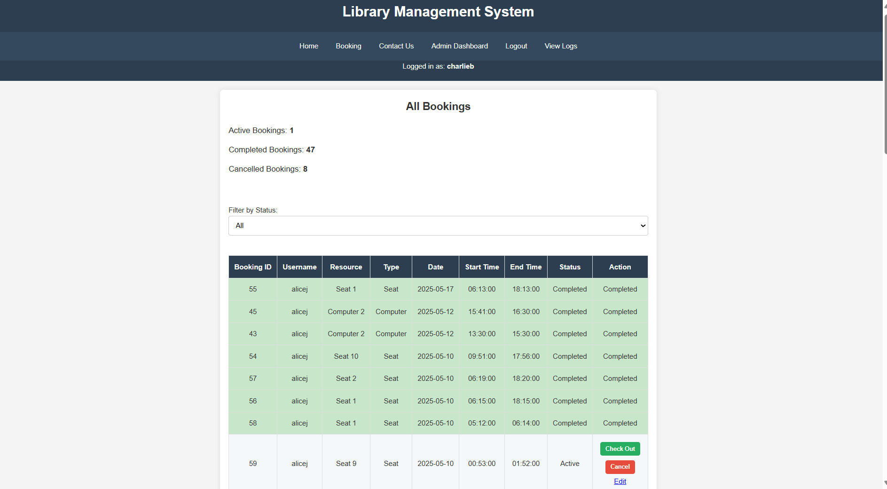
Smart booking
Live availability
Admin control
What Users Can Do

Slide 9
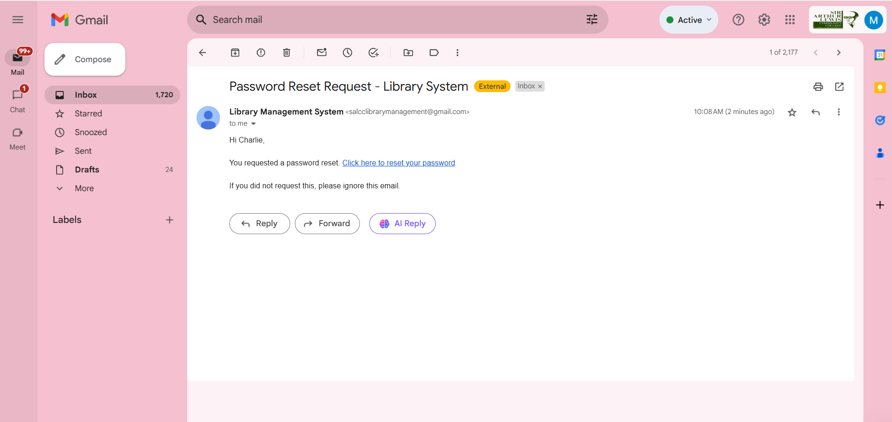
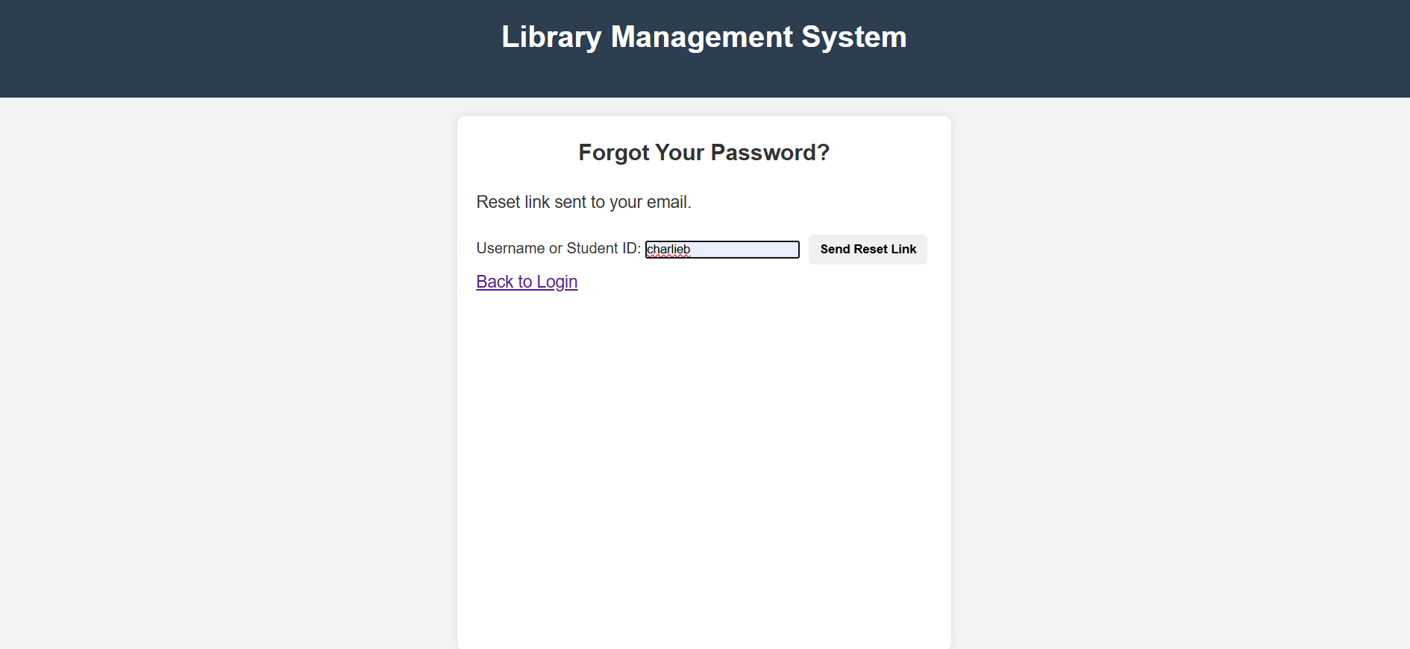
Is it secure?
Password-protected logins
Input validation for bookings
Access control (admin vs user)
Strong Authentication and Session Management

Slide 11
What Changed?
Before | After
Manual booking | Online booking
Limited availability | Live updates
No analytics | Admin dashboard

Slide 12
What We Learned
Struggled with PHP–DB sync early on
Grew in teamwork, backend logic, and UI design
Learned the value of version control and backup planning

Slide 13
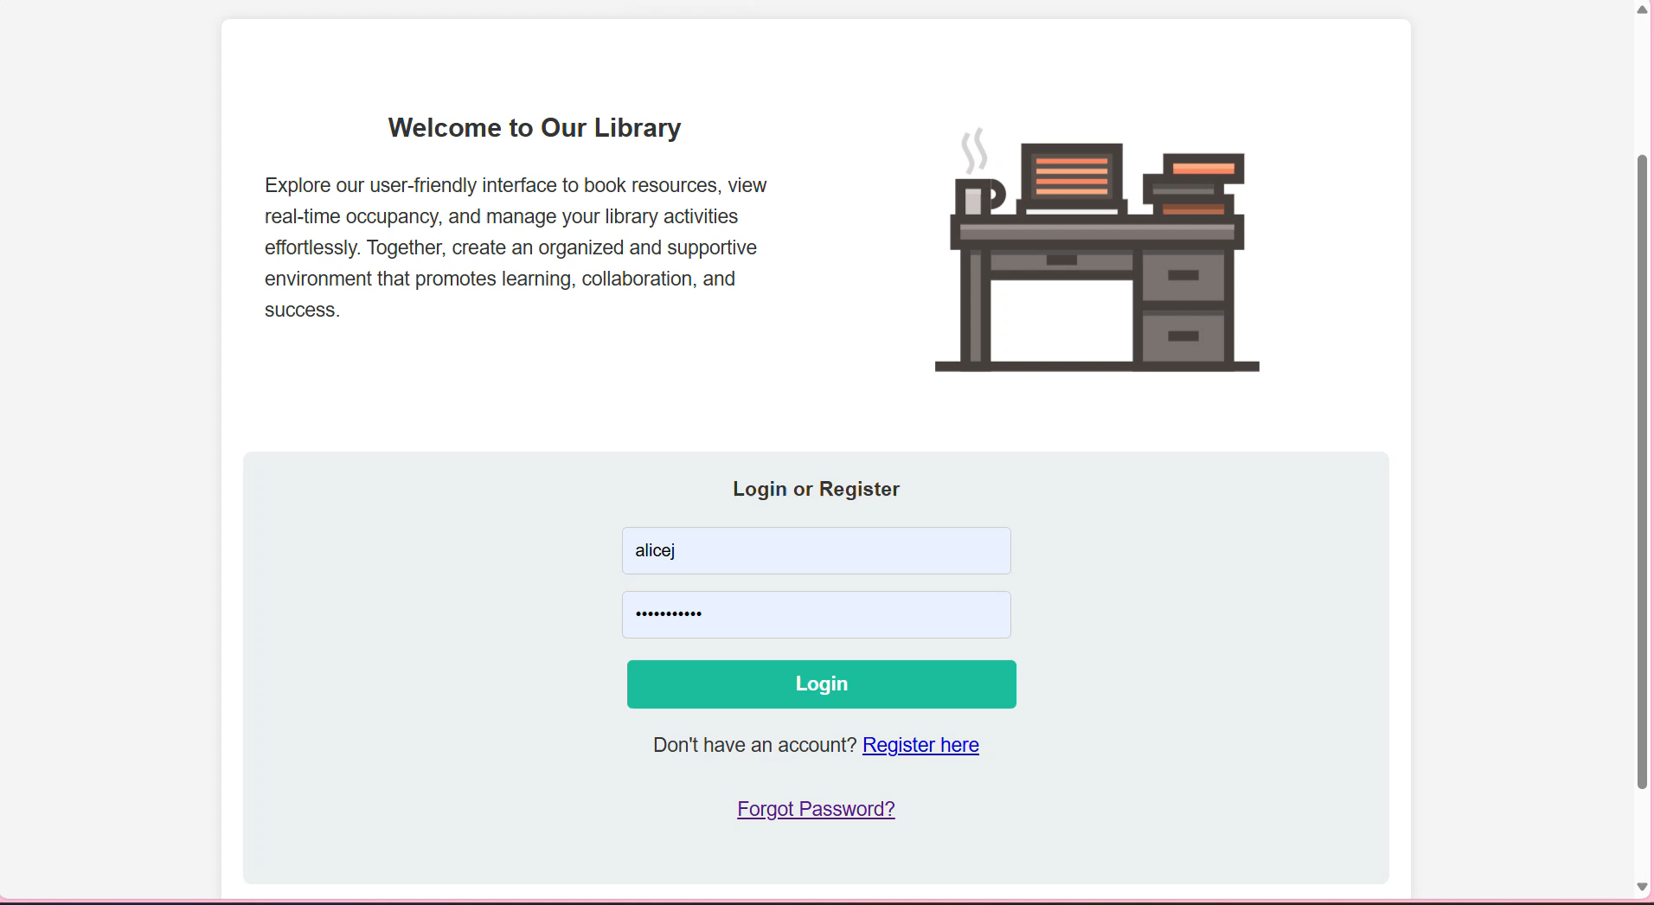
How do users interact with the platform?

Slide 14
What We Achieved & What’s Next
Mobile app for booking & tracking
Cloud database for remote access
Auto notifications (reminders & updates)
Fair use: 2 hrs × 2/day limit
Two-step registration security
QR codes for quick system access
User feedback guides improvements

Slide 15
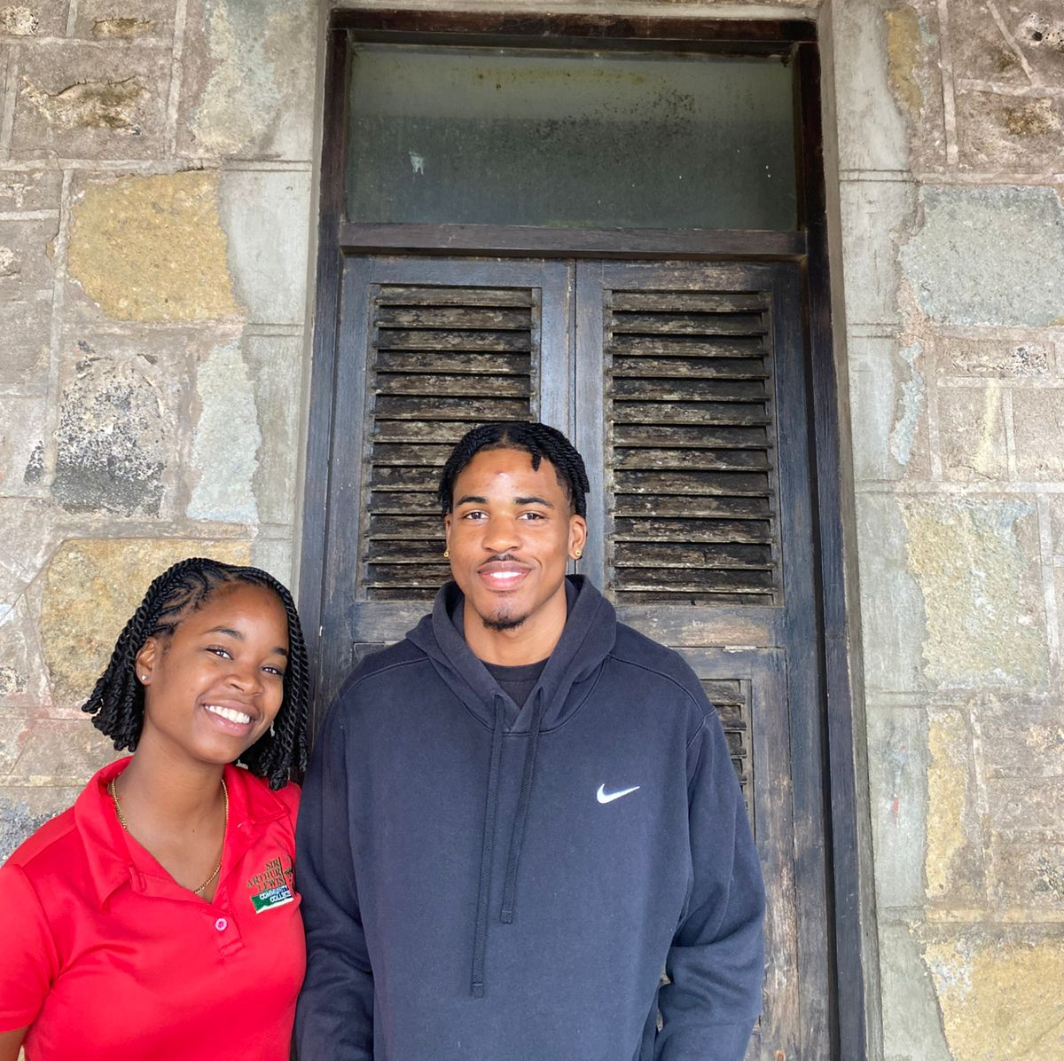
We Thank You.
Feel free to give feedback or ask questions of any!

